Slide 1
INTRODUCTION TO JAVASCRIPT

Slide 2
JavaScript is a powerful programming language used for creating dynamic and interactive web applications.
JavaScript is a lightweight, cross-platform, single-threaded, and interpreted compiled programming language which is also known as the scripting language for webpages.
JavaScript contains a standard library of objects, like Array, Date, and Math, and a core set of language elements like operators, control structures, and statements.

Slide 3
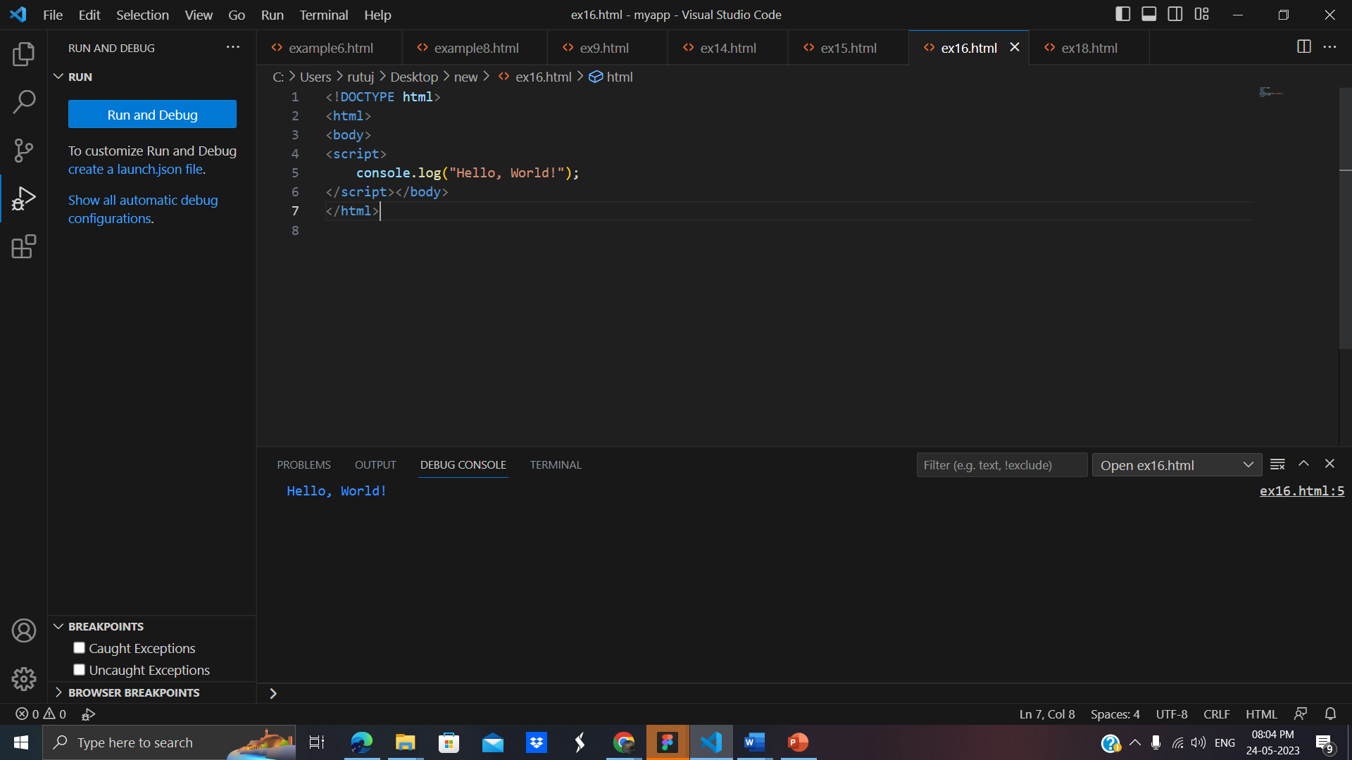
Let's start with a classic example: printing "Hello, World!" to the console.

Slide 4
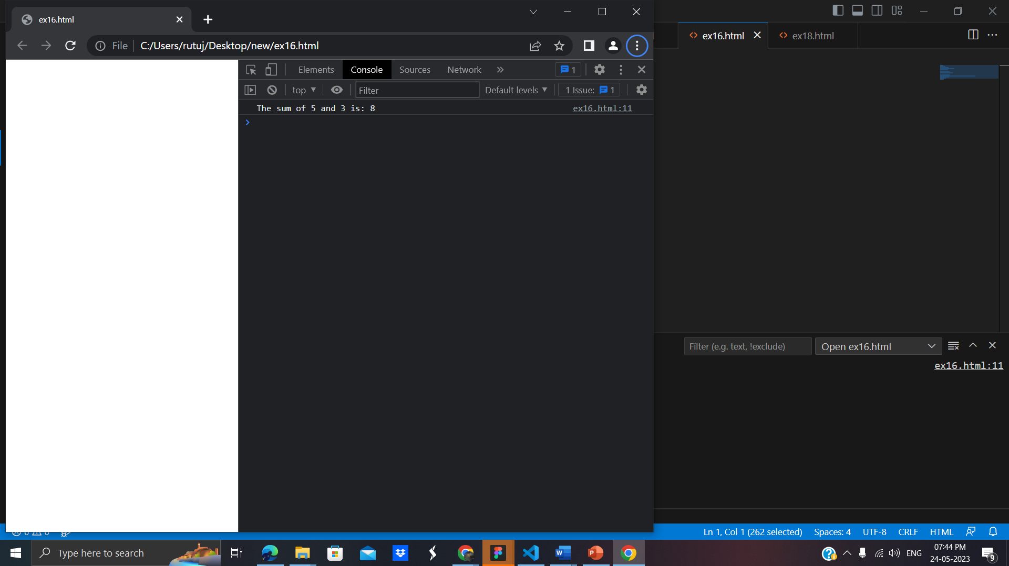
Program 2 - Variables and Arithmetic:
Next, let's explore variables and basic arithmetic operations.
Write the following code on the screen:
<html>
<body>
<script>
const num1 = 5;
const num2 = 3;
// add two numbers
const sum = num1 + num2;
// display the sum
console.log('The sum of ' + num1 + ' and ' + num2 + ' is: ' + sum);
</script>
</body>
</html>
So here sum have taken two values and after adding to numbers we obtained the result.

Slide 5
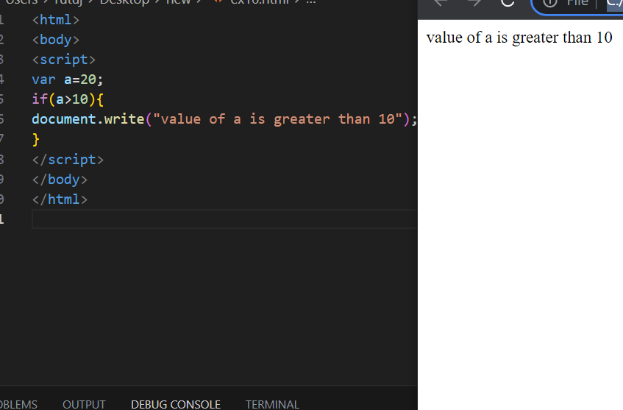
Conditional Statements
JavaScript provides conditional statements for decision-making in programs.
Write the following code on the screen:
for loop initializes a variable, checks a condition, executes the loop body, and updates the variable, if statement checks the condition and executes the appropriate block of code based on the result.

Slide 6
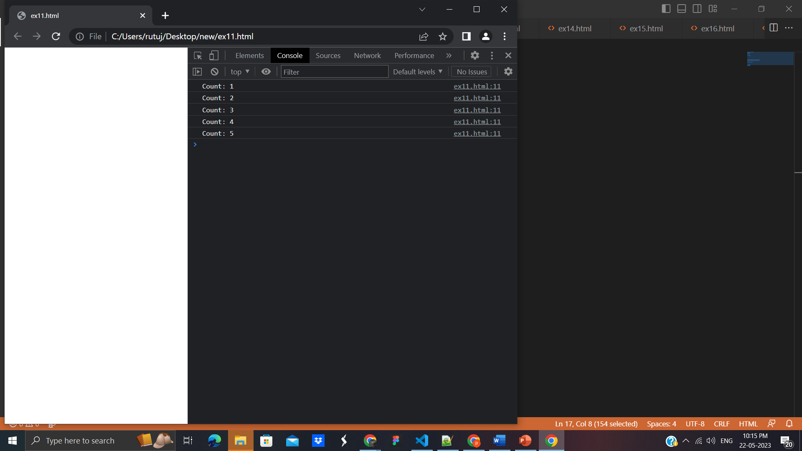
Program 4 - Loops
Loops help us repeat a block of code multiple times.
Write the following code on the screen
<!DOCTYPE html>
<html>
<body>
<script>
for (let i = 1; i <= 5; i++) {
console.log("Count: " + i);
}
</script>
</body>
</html>
for loop initializes a variable, checks a condition, executes the loop body, and updates the variable.

Slide 7

Program 5 - Functions]
Functions allow us to encapsulate reusable blocks of code.
Write the following code on the screen:
<!DOCTYPE html>
<html>
<body>
<script>
function greet(name) {
console.log("Hello, " + name + "!");
}
greet("John");
</script>
</body>
</html>
we define functions using the function keyword and can pass arguments to them.

Slide 8

Program 6 - DOM Manipulation]
JavaScript can interact with the Document Object Model (DOM) to modify web page elements.
Demonstrate a simple example using HTML and JavaScript code:
<!DOCTYPE html>
<html>
<body>
<button id="myButton">Click Me</button>
<script>
const button = document.getElementById("myButton");
button.addEventListener("click", function() {
console.log("Button clicked!");
});
</script>
</body>
</html>
we use the document.getElementById() method to select the button element and attach an event listener to it.

Slide 9
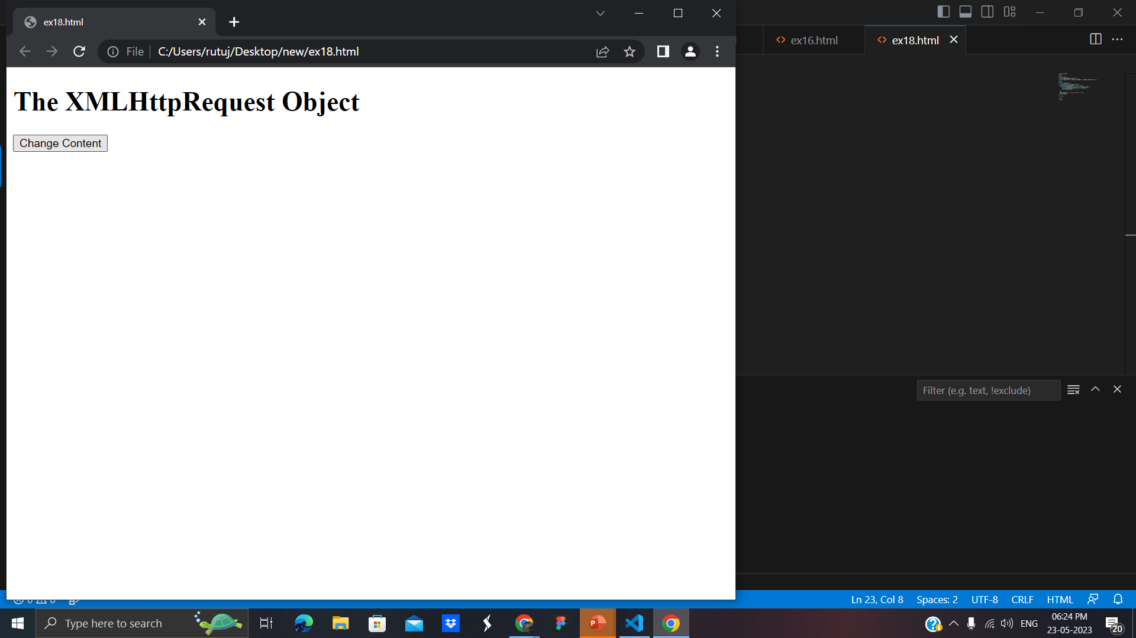
Program 7 - AJAX Requests]
JavaScript enables asynchronous communication with web servers using AJAX.
We will get to know the concept briefly and by using following code snippets.
<!DOCTYPE html>
<html>
<body>
<div id="demo">
<h1>The XMLHttpRequest Object</h1>
<button type="button" onclick="loadDoc()">Change Content</button>
</div>
<script>
function loadDoc() {
var xhttp = new XMLHttpRequest();
xhttp.onreadystatechange = function() {
if (this.readyState == 4 && this.status == 200) {
document.getElementById("demo").innerHTML =
this.responseText;
}
};
xhttp.open("GET", "ajax_info.txt", true);
xhttp.send();
}
</script>
</body>
</html>

Slide 10
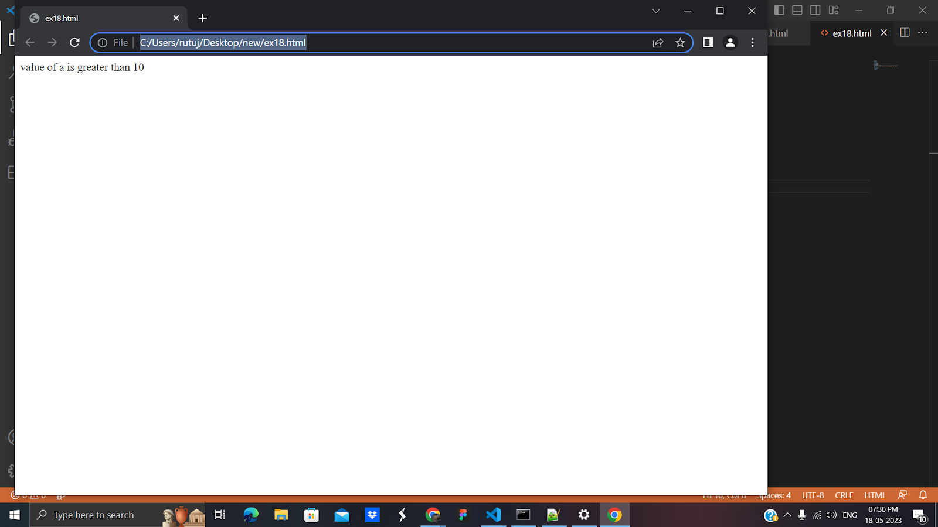
Program8:
JavaScript If-else
1.If Statement: It evaluates the content only if expression is true
<html>
<body>
<script>
var a=20;
if(a>10){
document.write("value of a is greater than 10");
}
</script>
</body>
</html>

Slide 11

2.If else statement
<html>
<body>
<script>
var a=20;
if(a%2==0){
document.write("a is even number");
}
else{
document.write("a is odd number");
}
</script>
</body>
</html>

Slide 12
9.JavaScript switch statement

